Slide 1

Distributed Computing in Flight Control Systems
Team: Tech Aviators
Mamta Pednekar
Sushma Kallapur

Slide 2

Introduction
Aircraft Avionics has evolved significantly since the development of the A320 aircraft.
The federated architecture in the airliner, assumed one computer for each function. Due to cost, space and weight issues, a new architecture came into picture namely “Distributed Integrated Modular Avionics Architecture”.
It consisted of shared hardware resources for different functions.
Satisfying the disadvantages of the earlier approach, new problems of dependencies, unpredictable behavior, troubleshooting and system modifications emerged.
In this paper, we focus on presenting a fully distributed approach to the flight control systems, its advantages and disadvantages.

Slide 3
Avionics Architecture
Avionics Architecture is the central part of modern aircraft.
The Architecture is mainly composed of processing modules and communication buses.
It primarily supports :
Flight control and management.
Navigation.
Communication.
Weather systems.
Collision avoidance systems.
Aircraft health monitoring systems.

Slide 4

Flight Control System
Flight control system (FCS) consists of flight control surfaces, cockpit controls and connecting linkages.
Aircraft engine controls are also considered as flight controls as they change speed.
Fly-by wire (FBW) Flight Control System replaces mechanical linkages with transducers, wires and actuators.

Slide 5
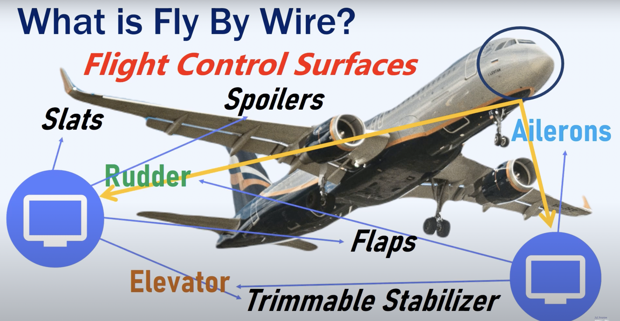
What is Fly-by-Wire ?
Fly by wire is a system which uses computers to move different flight control surfaces.
The term fly-by-wire has been adopted to describe the use of electrical rather than mechanical signaling of the pilot’s commands to the flying control actuators.
The fly-by-wire system would simply provide electrical signals to the control actuators that were directly proportional to the angular displacement of the pilot’s controls, without any form of enhancement.
Fig1: Fly-By-Wire

Slide 6
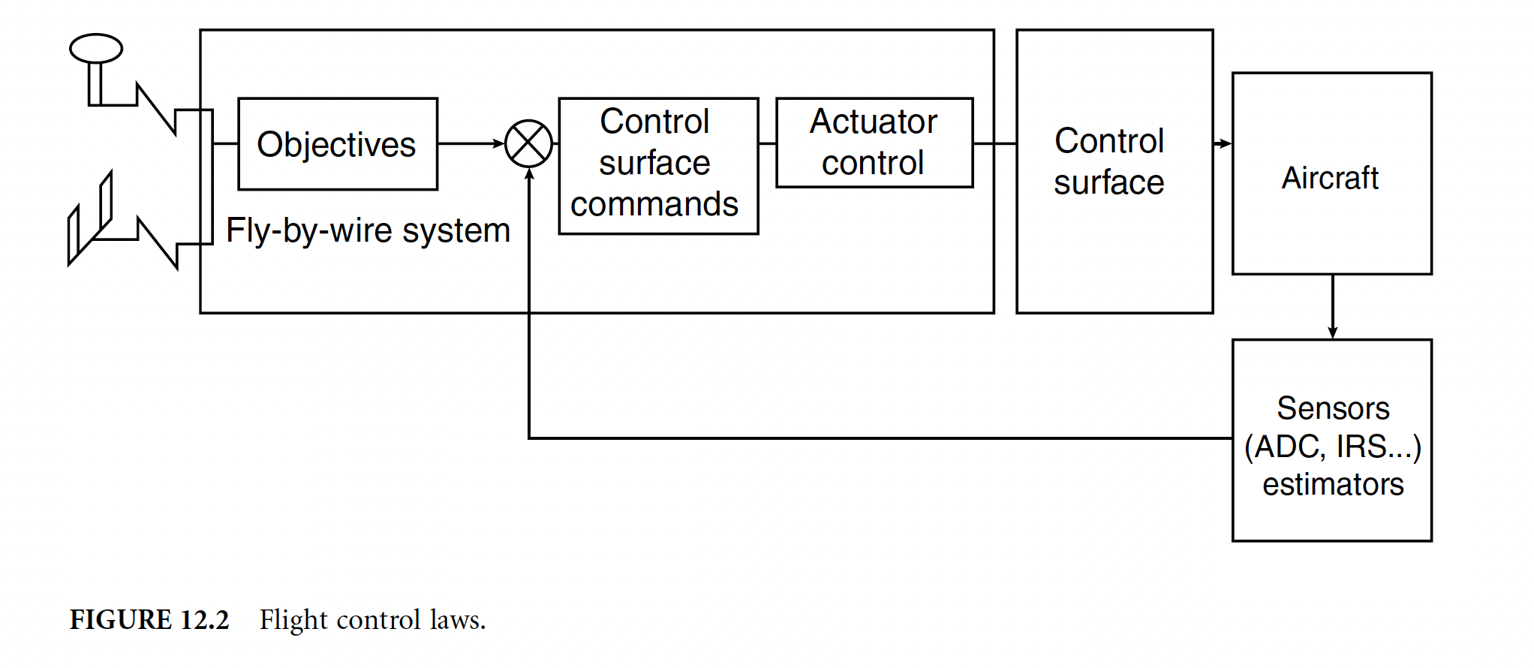
Fly-by-Wire (FWB) Contd…
Specific computers and actuators, driving the mechanical linkages restore the pilot feels on the controls and transmit the autopilot commands. (Fig 12.1)
In the design of the A320, A321, A330, and A340 flight, control systems takes advantage of the potential of fly-by-wire for the incorporation of control laws that provide extensive stability augmentation and flight envelope limiting. (Fig 12.2)
Fig2: Mechanical and Electrical Flight Control
Fig3: Flight Control Laws

Slide 7
FCS Performance Specifications and Requirements
FCS performs critical applications as flight stability augmentation, flight guidance and envelope protection. It must satisfy safety, dependability requirements and meet performance specifications:
Aircraft FCS must deliver the right commands to the control surfaces at correct time in coordinated fashion.
When one part of the system fails, then rest of the system must continue the operation within specifications called degraded mode.
Communication Network Latencies must be accounted during the system design.
Unforeseen events such as failure of any of the flight control computers, loss of communication system must not have disastrous impact on the performance of the system.
Safety analysis must be performed in accordance with Advisory Curricular AC25.1309.
Dependability, Safety and Real-time Constraints must be considered while designing the FCS.

Slide 8
Approaches
There are 2 approaches for Avionics Architecture design:
Federated Avionics Architecture
Integrated modular avionics architecture (IMA)

Slide 9

Federated Avionics Architecture
Federated Avionics is characterized by the one function – one computer concept.
The key benefits:
Dependencies between systems are easily identified.
Troubleshooting of federated systems is simplified.
Disadvantage:
Large number of different line replaceable units (LRU) comprising the system.
From operator standpoint : This causes difficulties, since large number of components need to be stored on stock for replacement purposes.
From the manufacturer standpoint: Each new subsystem adds weight to the aircraft, reducing passengers and cargo capacity.

Slide 10
Integrated Modular Avionics (IMA) Architecture
In order to achieve reduced weight and optimize power, the integrated modular avionics (IMA) architecture is used.
It allows optimizing the airframer avionics.
The IMA concept is based on sharing hardware resources namely IMA processors that are running on separate software modules for each system.
Benefits:
IMA have overcome some of the shortcomings of the federated avionics architectures.
The IMA architecture provides a common I/O, communication line and computing resources, that is shared among the various avionics’ functions.
Reduced number of computer and communication data cabling.

Slide 11
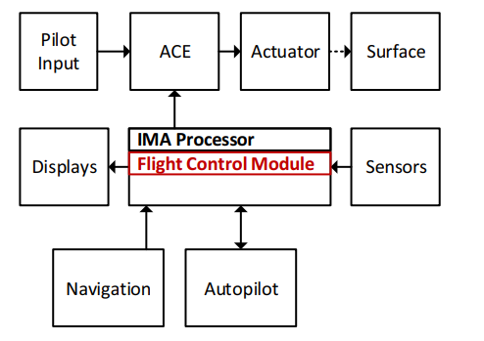
Integrated Modular Avionics (IMA) Architecture (Contd..)
Disadvantages:
Troubleshooting Issues.
Dependencies arising because of shared hardware resources and data channels.
Fig4: Distributed IMA

Slide 12
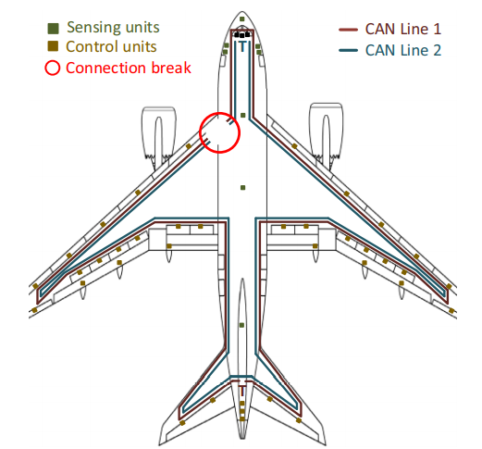
Fully Distributed Flight Control System
A distributed network of embedded Control Units performing various Flight control functions on or near the control surface actuators.
Controller Area Network.
Fault Tolerance of the CU.
Fig5: FDFCS CAN network routing

Slide 13
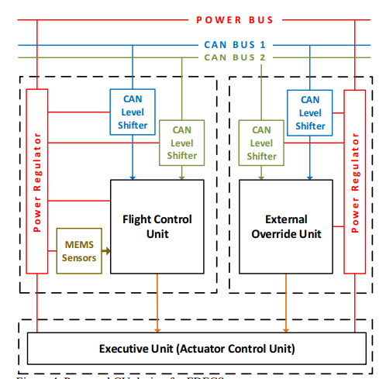
Proposed Architecture Design
Flight Control Unit - FCS functions and and roles
External Override Unit - sole purpose of overriding the FCU outputs on a certain event
Actuator Control Unit or Executive Unit- The role of this unit is to manage actuator(s) connected in a way ordered by FCU and when overridden, the EOU.
Regulation and Communication level Translators
MEMS Sensors are not as effective as the IRU.
Fig6: Proposed CU design for FDFCS

Slide 14
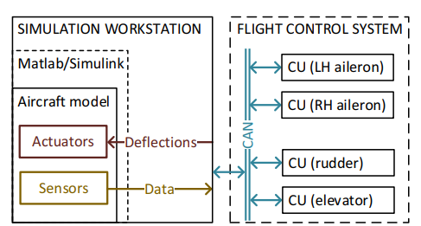
Flight Control System – Transmission, broadcasting, Normal Mode and Emergency
Time triggered and event triggered events.
GPS receivers and IRUs should broadcast data on the network on regular intervals to assure that all the units have the positioning data corrected at certain regular interval.
CUs should communicate between each other on a specific event, only when communication is required to perform FCS functions.
In the emergency event of loss of many systems, the degraded mode of operation should be available.
Flight Normal Mode.
Fig7: Simulator for the FDFCS

Slide 15
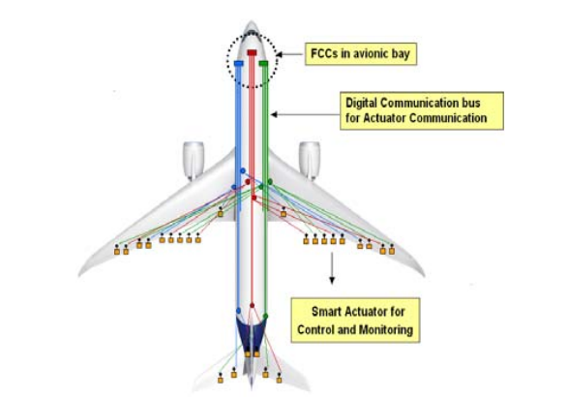
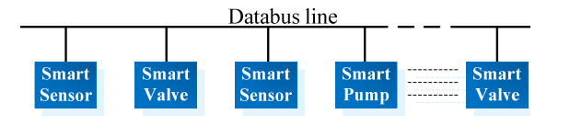
Emerging technologies related to flight control systems and Future Work
Case Study 1: State of the Art in current aircraft distributed control systems.
Case Study 2: MEMS based FCS.
Case Study 3: UAV swarms.
Case Study 4: Fault Detection and Isolation.
Case Study 5: Distributed optimisation.
Fig8: FDFCS Architecture
Fig9: Architecture of the distributed fuel control system

Slide 16

Future Work
Control Units will be designed to operate the Flight Control System
HIL Simulator emulation
Detailed logging and analysis of data traffic in order to create procedures to enable certification tests of the proposed architecture and in-depth performance analysis.

Slide 17

Challenges
The whole control structure needs to be identified beforehand
Decomposition of a complex system
Wired and wireless networks
Timing problems

Slide 18
Conclusion
Distributing the FCS logic to actuators removes the need for any sophisticated computers performing FCS function in the avionics bay.
Routing of sensory and data wiring is unnecessary, resulting in reduction of aircraft weight.
The complexity of the system reduces significantly especially because of integrating MEMS sensors into the CUs.
fitting CUs directly on or near the actuators surely reduces latencies caused by usual over the network control of actuators.
The ease of troubleshooting of the system is expected by introduction of fault detection and self-testing functions.

Slide 19
References
M. Šegvić, K. Krajček Nikolić and E. Ivanjko, “A Proposal for a Fully Distributed Flight Control System Design,” in MIPRO 2016, May 30 - June 3, 2016, Opatija, Croatia.
Eric Noulard, Pierre Bieber and Marc Boyer “New Challenges for Future Avionics Architecture,” in ResearchGate, May 2012.
Dominique Briere, Christian Favre and Pascal Traverse, “Electrical Flight Controls, From Airbus A320/330/340 to Future Military Transport Aircraft: A Family of Fault-Tolerant Systems” in CRC Press LLC, 2001.
M. Šegvić, K. Krajček and E. Ivanjko, “Technologies for Distributed Flight Control Systems: a Review” in MIPRO 2015/CTS, 2015.
Youtube.com.
Wikipedia.com.

Slide 20

Questions?

Slide 21

Thank You!!

